Slide 1
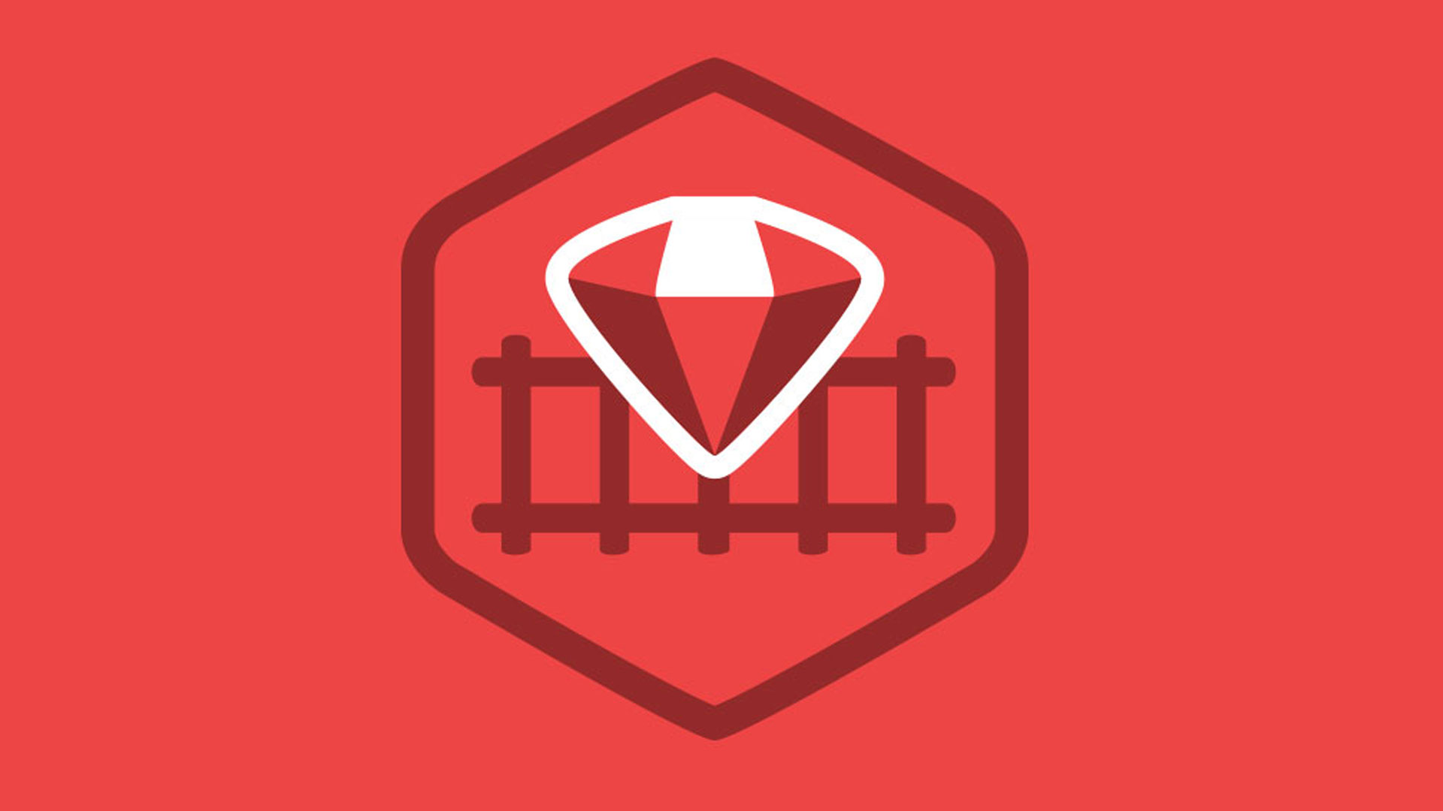
Ruby on Rails

Slide 2
About today…
React.js with RoR
Integrate React.js directly within a RoR application
(Combining both frontend and backend in a single codebase)
BENEFIT
Simpler setup, easier routing and data passing, leveraging RoR's asset pipeline

Slide 3
Directly Integrating React.js into RoR

Slide 4
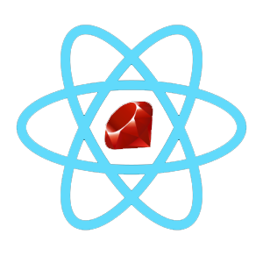
Setting Up RoR with React.js
Create Rails App
rails new task_manager
Navigate to Directory
cd task_manager
Add React-Rails Gem
Add gem 'react-rails' to Gemfile, then run
bundle install
Install React
rails webpacker:install:react

Slide 5
Generate React Component
Generate Component
rails generate react:component TaskApp
Directory Structure
React components will be in
app/javascript/components

Slide 6
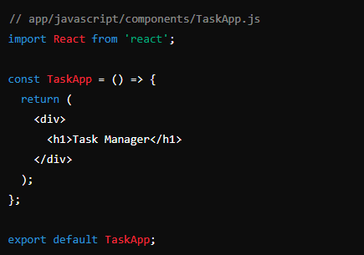
Creating Basic React Component
Component Example

Slide 7

Embedding React Component in RoR View
View Example

Slide 8

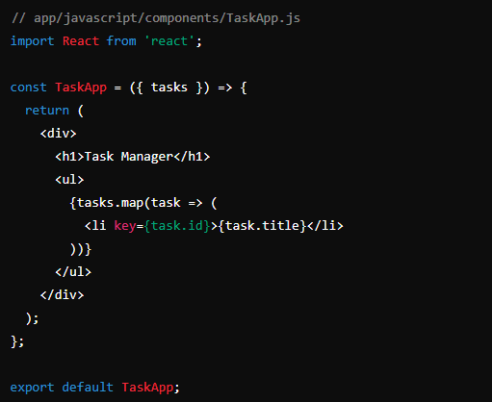
Passing Props from RoR to React
Example
Receiving Props

Slide 9
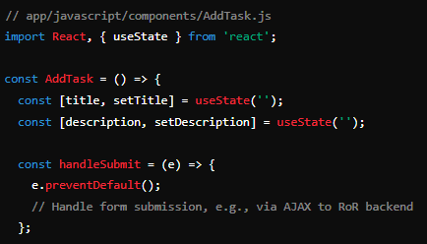
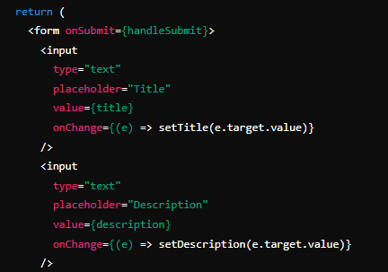
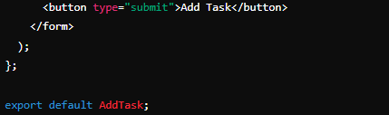
Handling Form Submission in React

Slide 10


Slide 11

What is one of the main benefits of directly integrating React.js into a RoR application?
Simpler setup and easier routing
Which command is used to create a new Rails application named task_manager?
rails new task_manager
Where are React components stored in a Rails application integrated with React-Rails?
app/javascript/components
Which gem needs to be added to the Gemfile for integrating React with Rails?
react-rails
How do you pass props from a Rails view to a React component?
<%= react_component('ComponentName', { key: value }) %>

